Slide 1
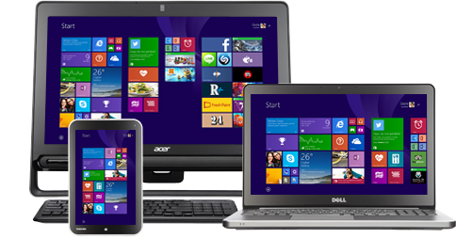
Writing Universal Apps for Windows and Windows Phone
Greg stoll
10/18/2014

Slide 2





Thank you to our sponsors…
Austin .Net User Group
Codecamp 2014
GOLD
Happy Hour sponsor
Bronze

Slide 3
About me
I’m the former Nokia Developer Ambassador for Windows Phone. I’ve been writing Windows and Windows Phone apps for 3 years – find them under publisher name gregstoll.com.
Notes:
<intro about self>
Just to let you know, there will be a link to the slides at the end of the presentation – the notes contain a lot of links with more information.

Slide 4
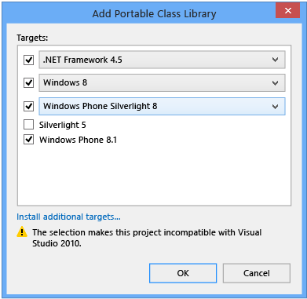
Portable Class Libraries
Notes:
Since the .NET Framework was released in 2002, various parts of it have been ported to a bunch of different platforms – for example Windows Desktop, Windows on ARM, Windows Phone, Silverlight, and Xbox. Before universal apps, Microsoft’s solution for writing portable .NET code was Portable Class Libraries, which became available in .NET 4.0. It lets you target specific OS/.NET Framework versions. This can be a very useful place to put your models, etc., but you’re limited to the APIs that all of your selected targets have _in common_, which can be fairly limiting. You get to build one target binary which works on multiple platforms (through some .NET magic), but if you need to do anything differently on a particular platform you have to use something like dependency injection.
See http://msdn.microsoft.com/en-us/library/gg597391%28v=vs.110%29.aspx for more info.

Slide 5
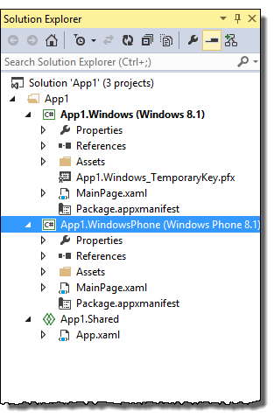
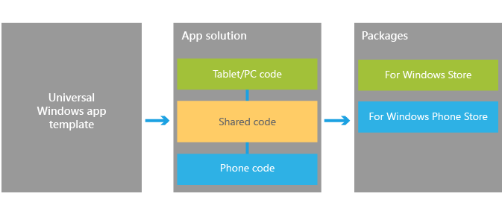
Universal Apps
Notes:
Universal apps let you target Windows 8.1 and Windows Phone 8.1 at the same time. This is done with a Shared project (seen at the bottom in the project list). The downside is that you can only target Windows/Windows Phone 8.1, but the upside is you can use #if’s to include Windows or WP-specific code in the Shared project. This opens the door to moving a lot more of your app’s logic into the shared project.
(and someday target Xbox too!)

Slide 6
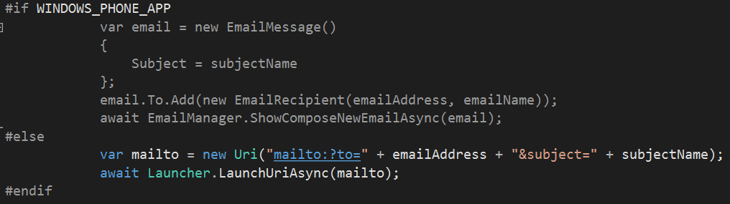
Universal Apps – conditional compilation
Notes:
Here’s an example of what this looks like. This is a method in a shared project that sends some email. Unfortunately the APIs for these aren’t the same in Windows and Windows Phone, so I had to write separate code for the two platforms.
This is based off of linked files in Visual Studio – essentially all of the files in a Shared project are included in the Win and WP build. Right now Shared projects are only available in universal apps, but Microsoft has hinted that they might be coming to more types of Visual Studio apps.
To be clear, the Shared project doesn’t produce a binary by itself (unlike PCLs), the source files just get sucked in to all of the projects that it’s shared with. This makes Shared projects unsuitable if you need to share code outside of the solution it’s contained in.
One nifty technique you can use is define a partial class in the Shared project and then define platform-specific implementations, etc. in the Win and WP projects.

Slide 7
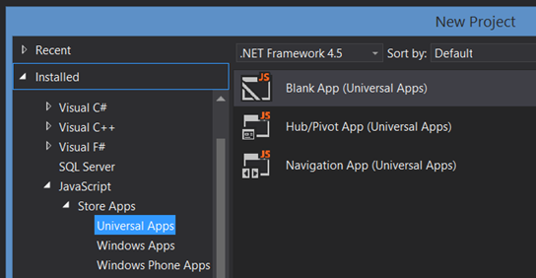
Universal Apps – new languages
XAML/C#/VB/C++
HTML/JS
Notes:
In Windows 8, you can write apps using XAML for the UI and C#/VB/managed C++ for the code, or HTML for the UI and Javascript for the code. With Universal Apps you can do this as well for Win 8.1/WP 8.1 (or just WP 8.1, if you like!)

Slide 8
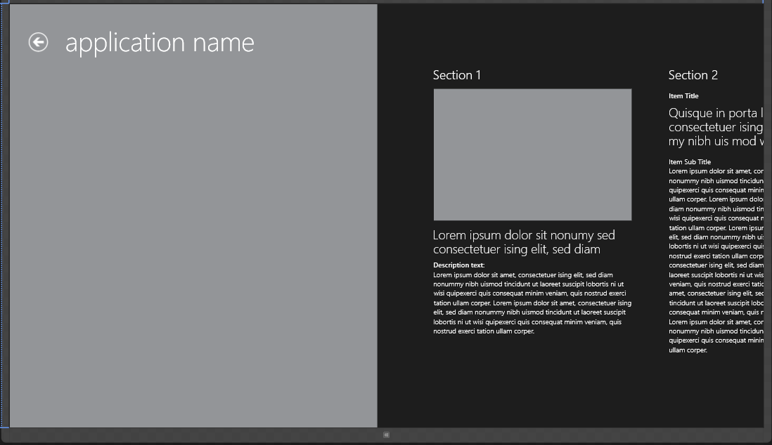
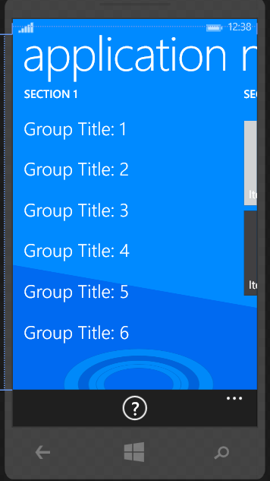
Universal Apps – converged controls
Notes:
One new feature of Universal Apps is controls that work on Windows and Windows Phone, but adapt differently to be more appropriate. The Hub control is a good example – here you can see screenshots of what it looks like on Win and WP. Notice that the Windows version takes advantage of more horizontal space to make the header “application name” more prominent, while it remains at the top in the WP version. The Windows version also allows multiple hub sections to show at once (since it has to be more adaptable to different resolutions), while the WP version prefers showing one hub section per screen. The purpose of both controls is the same, though, and you could use very similar markup and get platform-appropriate results. (this was formerly known as a “Panorama” control on WP Silverlight)

Slide 9
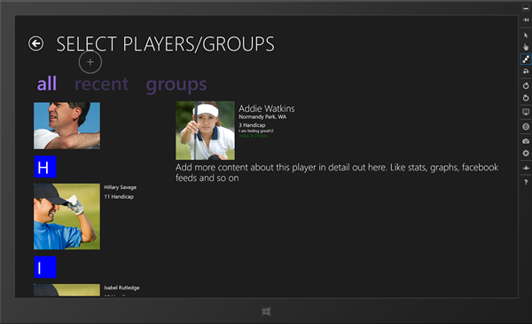
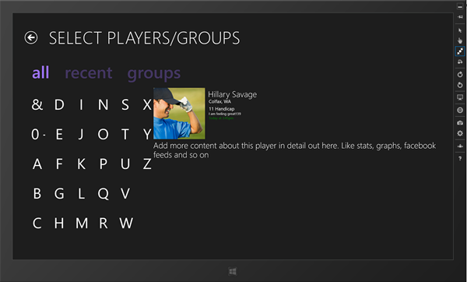
Universal Apps – converged controls
Notes:
Another example is the Semantic Zoom control. This lets you navigate a long list (see the list of golfers on the left), and when you “zoom out” by pinching you see the whole list of starting letters. When you click or tap on one of the letters, it jumps you to that letter in the list, kind of like an address book.

Slide 10
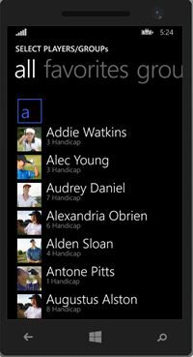
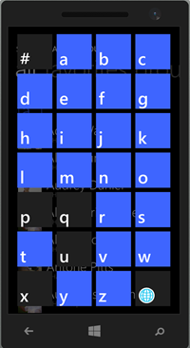
Universal Apps – converged controls
Notes:
Semantic Zoom on Windows Phone looks similar. In this case, you tap the outlined letter (like the “a” on the left), and this brings up the list of starting letters, which takes up the whole screen since there’s less screen space to use and they still need to be easily tappable. This was formerly known as the LongListSelector in Silverlight.

Slide 11
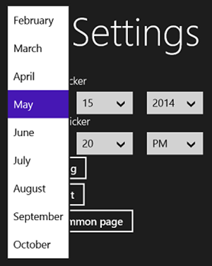
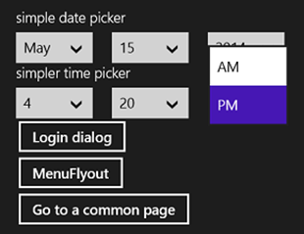
Universal Apps – converged controls
Notes:
Similarly, on Windows the DatePicker and TimePicker display inline in your page…

Slide 12
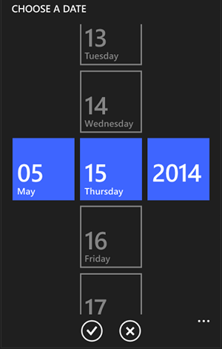
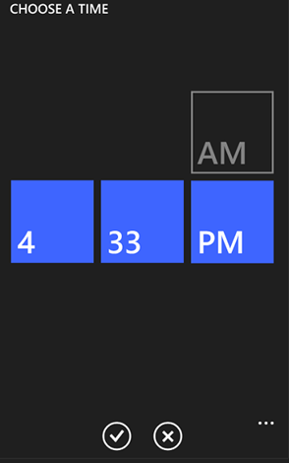
Universal Apps – converged controls
Notes:
…while on WP they get a full screen view with OK/Cancel buttons at the bottom of the page.

Slide 13
Universal Apps – converged controls
XAML reuse!
Notes:
Why does this matter? Well, the short answer is that this makes it possible to reuse XAML between Windows and WP. While there remain some controls that are Windows or WP specific and there are some differences in the properties, etc. available on the platforms, this is theoretically possible. How practical is it? More on that later…

Slide 14
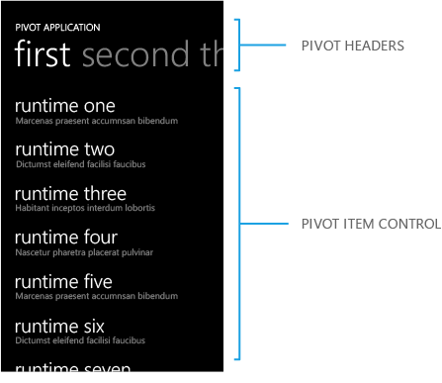
Universal Apps – phone-specific controls
Notes:
To be clear, there are still some example of phone-specific controls. One big example is the Pivot control seen here. I don’t think this control really makes much sense on Windows since there is so much more width to use, so I would be surprised to see this ever come to Windows. Some other examples are the AutoSuggestBox and ContentDialog. (which is used as a simple dialog box)
See http://msdn.microsoft.com/en-us/library/windows/apps/xaml/hh465351.aspx for a list of all XAML controls.

Slide 15
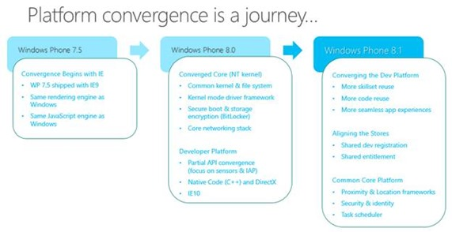
Universal Apps
Notes:
Microsoft has been working on platform convergence for a while – even all the way back to WP 7.5 it used the same IE rendering engine as Windows, and they’ve taken giant steps forward since then. There are even rumors that future phones will drop the Windows Phone name and just call it “Windows”. (i.e. “HTC One (M8) for Windows”)

Slide 16
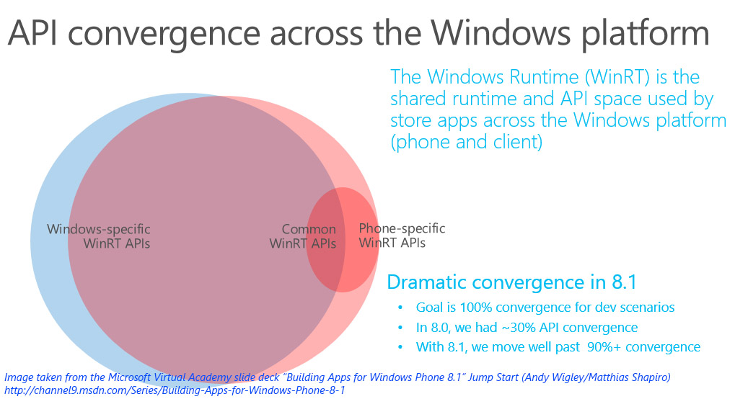
Universal Apps
Notes:
Here’s an image that Microsoft has used to represent how close the APIs are now. You can see they’ve made a ton of progress between WP 8.0 and 8.1.

Slide 17
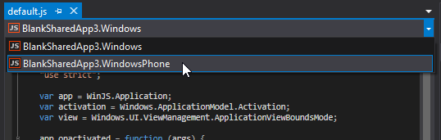
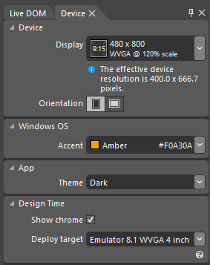
Universal Apps – Visual Studio support
Notes:
Visual Studio 2013 Update 2 has some nice features for working with universal apps. One is the context switcher, seen on the left here. This is a dropdown that lets you select an “active” target in your app, and makes Intellisense and syntax highlighting work for that target. Intellisense will also flag APIs that aren’t available on other platforms.
The Device tab now supports Windows Phone as well as Windows, where you can set the screen resolution, orientation, accent color, etc. which are used in the XAML design window.

Slide 18
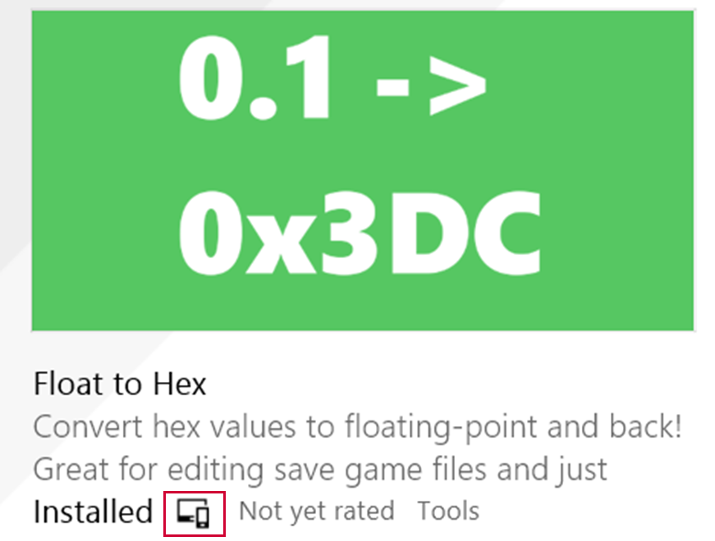
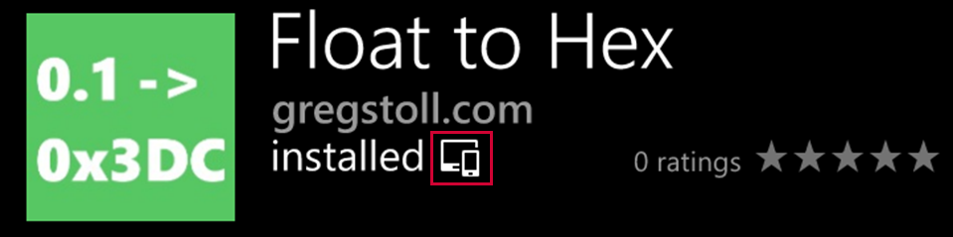
Universal Apps – Store presence
Notes:
When you build your Universal App the separate platforms are built into .appx or .appxupload files separately. The way the apps become linked is that you have to reserve the same app name for them in the Windows Store and Windows Phone Store. Once you’ve done that, the “universal” icon (shown in the red box) shows up in both stores, and users will only have to buy the app once. In addition, if you use durable in-app purchases with the same name, buying one on either platform will make them show up on both platforms. The apps will share data roaming and backup APIs, and they will get a single push notification channel.

Slide 19
Universal Apps - demo
Notes:
<switch to VS 2013>
Let’s create a new Universal app. <new project, go to Visual C#> Visual Studio ships with a Blank App template, which is very bare-bones. The Hub App is a good template to start with, so let’s see what that looks like. <choose Hub app>
<switch to XAML for Win and WP> Here you can see the Hub control featuring in both the Win and WP apps. Note that while they both use the Hub control, in this template they don’t actually share any XAML. The template does give you a loosely-typed ViewModel in both apps and some simple code to handle the back button in Windows Phone (and an on-screen back button in Windows).
So what do the templates share? <scroll down to Shared project> Well, they share the model, some helper classes for handling app suspension and resume, some asset images, a few strings, and the main App.xaml where you define your resources that are shared across the app – this is a great place to put ValueConverters, for example.
<go to Shared project, open Common\NavigationHelper.cs, scroll down to constructor> Here’s a file in the Shared project, you can see it uses the “#if WINDOWS_PHONE_APP” to separate out phone-specific code. In this case, it’s handling the hardware back button pressed event, which doesn’t exist on Windows.
Another thing they don’t share is their app manifest. <show Windows version> This is where you define things like the app’s name, tile images, capabilities, etc. This means that when you update the version, etc. you have to be sure to update both manifests.

Slide 20
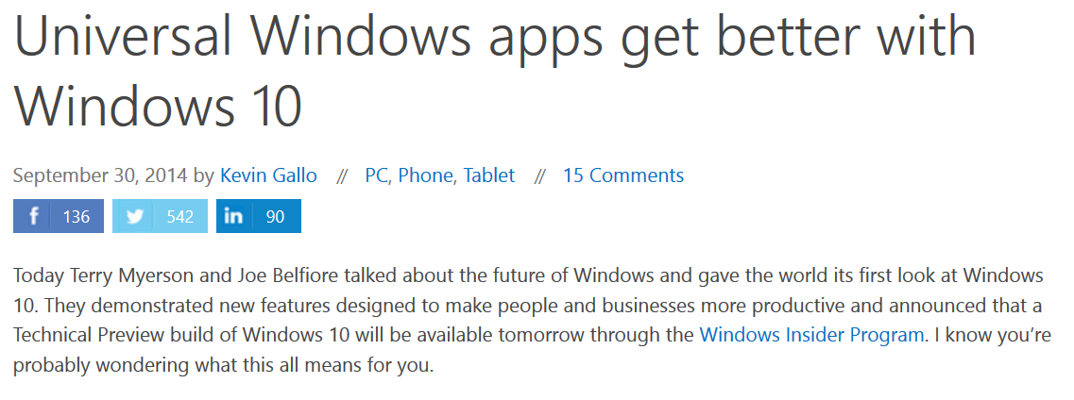
Universal Apps are the future!
Notes:
Microsoft recently announced Windows 10 and specifically called out universal apps as something that they will continue to improve and support. A few of the things they mentioned are having one unified store across all devices and running Windows Store apps on the desktop.
(link: http://blogs.windows.com/buildingapps/2014/09/30/universal-windows-apps-get-better-with-windows-10/ )

Slide 21
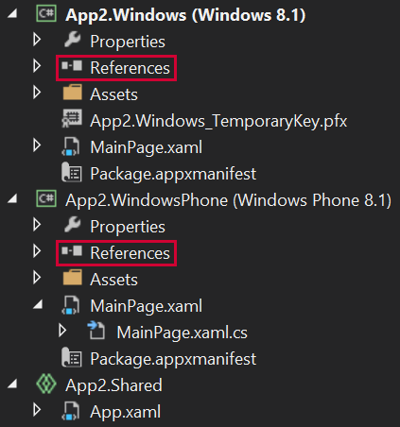
Universal Apps - caveats
Notes:
OK, let’s talk about some of the caveats to using Universal Apps. I should say that I like writing universal apps and plan on doing exclusively so in the future, so treat these as some tough love.
One small caveat it that Shared projects don’t have references – only the Win and WP projects do. This means if you want to use an external NuGet package in a Shared project, you have to install both the Windows and WP versions under their respective projects. This isn’t a huge deal, just something to be aware of when you’re working on a universal app.

Slide 22
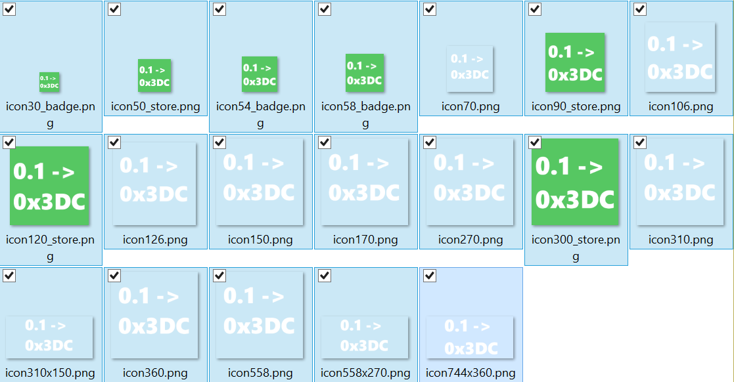
Universal Apps - caveats
So many icons!
Notes:
Another annoyance is the crazy number of icons you have to make. For the Float to Hex Windows and Windows Phone apps, I had to make 19 icons of various sizes as well as 3 splash screens. (it’s possible I made a few extra, but it’s something like that)
The splash screen is sort of an odd situation – in WP 7.1 apps launched fairly slowly, so you had to have a splash screen. In WP 8.0 apps started launching a lot faster (because of pre-JITting or something?), so the recommendation was not to include a splash screen. In WP 8.1, apps still launch fast, but now a splash screen is required again! The stated reason is to be similar to Windows apps, which are required to have a splash screen.

Slide 23
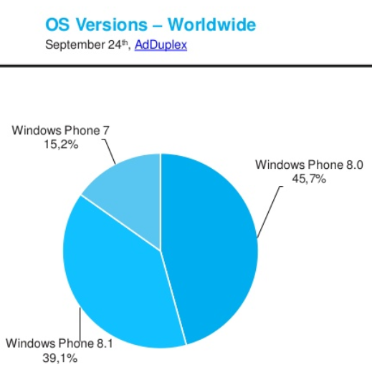
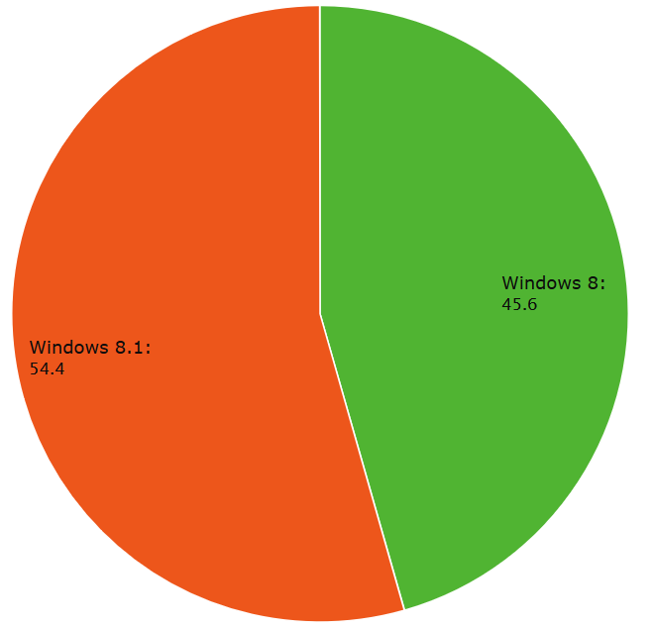
Universal Apps - caveats
Notes:
Another caveat is that Universal Apps are only available on WP 8.1 and Windows 8.1. The good news is that both of these OS’s are free upgrades from the previous version, which always helps adoption! You can see WP 8.1 is nearing 50% marketshare among all Windows Phones, and Windows 8.1 is already ahead of Windows 8. (although still a good deal behind Windows 7 and XP)
WP 8.1 – 39.1% of all WP
Win 8.1 – 56.4% of Win 8.x
WP stats from AdDuplex: http://blog.adduplex.com/2014/09/adduplex-windows-phone-statistics.html
Windows stats from NetMarketShare: http://www.netmarketshare.com/

Slide 24
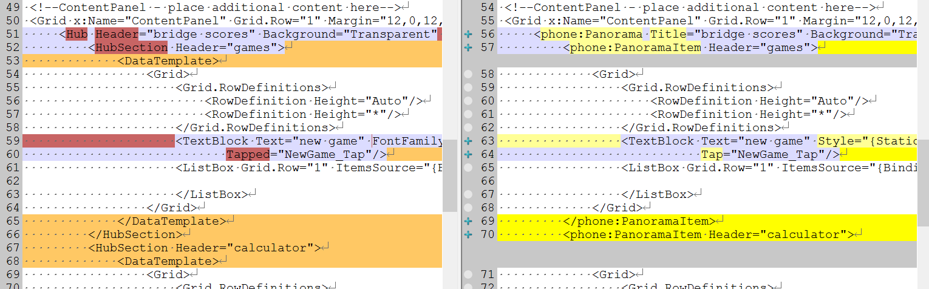
Universal Apps - caveats
WP 8.0 Silverlight -> 8.1 WinRT transition is tough
Notes:
A little background:
To write WP apps for WP 8.0 (or 7.1 for that matter), you used the Silverlight framework. In WP 8.1, Microsoft includes that framework (and even added some new APIs!), but using the WinRT framework (like used in Windows Modern apps) is required for Universal apps. Unfortunately, there are quite a few differences between the APIs. I was in the middle of writing a WP 8.0 app when Universal apps were announced, and so I decided to port it to use WinRT before adding any more features. It took a lot more work than I expected – while a lot of the changes were fairly mechanical (changes of namespaces, etc.), a good chunk were not and it took some trial and error to figure out what the right WinRT equivalent was.
See http://msdn.microsoft.com/en-us/library/windows/apps/hh465136.aspx for a good guide to porting from Silverlight to WinRT.

Slide 25
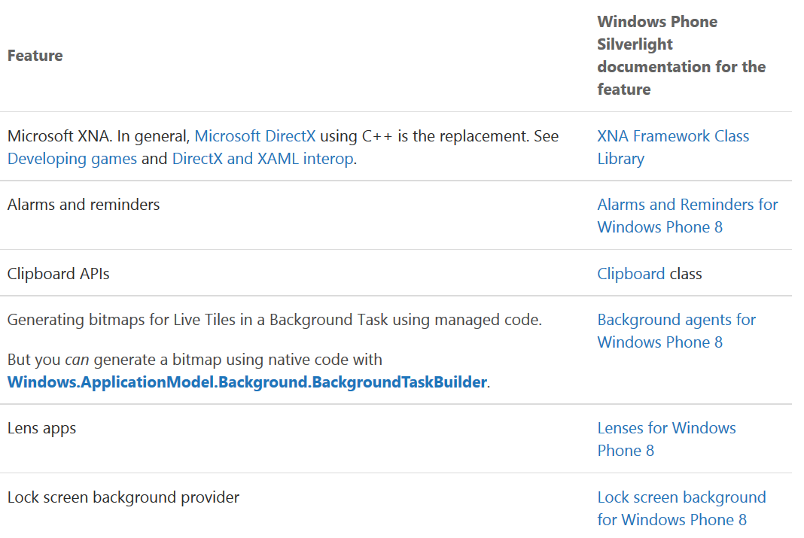
Universal Apps - caveats
WinRT missing APIs
Notes:
In addition, there are some APIs that just aren’t available in WinRT for Windows Phone. The big ones are alarms and reminders, clipboard APIs, and generating bitmaps for live tiles using managed code. (although you can do this in native code)
Obviously, this is a showstopper if you’re planning on writing an app that uses any of these features. My personal theory is that Microsoft just ran out of time in creating the WinRT APIs for Windows Phone, and that most of these will be coming to the platform in the near future…I’ve heard some rumors about clipboard APIs, at least…
See http://msdn.microsoft.com/en-us/library/windows/apps/hh452743.aspx for a complete list of what’s missing in the WinRT APIs for Windows Phone.

Slide 26
Universal Apps - caveats
Sharing XAML is hard!
Notes:
Microsoft did a lot of work in converging the Windows and WP XAML controls. Unfortunately, there are still enough differences that sharing XAML between Windows and Windows Phone is somewhat painful. When I created my Universal App template (link at the end!), I wanted to create About pages that were shared between Win and WP. I did accomplish this but it took a few creative workarounds since the platforms don’t share defined text sizes, etc. It’s also tricky because unless your app exactly fits one of the converged controls (like the Hub), you’ll want some differences in layout between Win and WP since the screen sizes are so different.
Microsoft recommends creating controls in the Shared project, and then using these in the Win and WP projects separately. If you’re going to do this, I highly recommend looking at the //build 2014 session “What about XAML UI and Controls?” ( http://channel9.msdn.com/Events/Build/2014/2-516 ) In any case, this requires a bit more planning before just diving in and implementing the WP XAML followed by the Win XAML.

Slide 27
Resources
My developer articles: http://bit.ly/wpdevarticles
Universal app template: http://bit.ly/universalapptemplate
These slides: http://bit.ly/universalappstalk
Win/WP email list: http://bit.ly/wpdevemail
greg@gregstoll.com
@gregstoll
Thanks!

